Slide 1
Positive Behavioral Interventions and Supports – Tier 2; Day 2
Lori Lynass, EdD
Bridget Walker, PhD
Sound Supports LLC
www.soundsupportsk12.com

Slide 2
Agenda: Tier 2- Day 2
GOAL: Build a Strong Tier 2 Foundation
Review of Tier 2 Major Concepts from Day 1
Setting Up Your Tiered Support Model
Introduction to Tier 2 Interventions
Set Up and Implementation of Tier 2 Interventions

Slide 3
Group norms and expectations
Be Responsible
  Be an active participant
  Return promptly from breaks/activities – Hand/Bell Signal
  Use cell phone/laptop to support learning
  Be Respectful
  Use time well & meaningfully
  Ask relevant/clarifying questions
  Leave no trace- clean up your space
  Be Professional
  Enter discussion with an open mind
  Share the Air with others- all voices heard
  Allow quiet think time for self and others FIRST
  Be The Student You Wish To Have

Slide 4
Big Ideas from Day 1: Pair Up Across Schools
Tier 1 in Classroom &
Tier 2 Readiness
Share strategies identified about using the CMSA
What are key features of a school ready for implementing Tier 2?
Team Structures, Function and Intervention Matrix
Share how your school is developing its Tier 2 team?
What Tier 2 interventions do you have in place?
How do use function of behavior to match students to interventions?

Slide 5
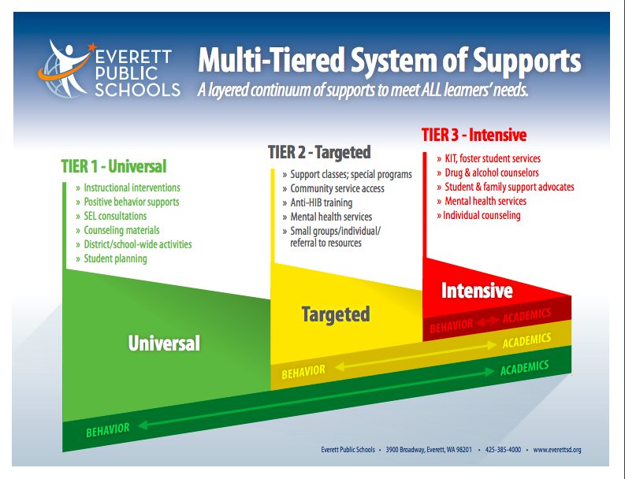
PBIS/MTSS-B In Everett Public Schools
Notes:
AB-

Slide 6
Tier 2 Targeted
Designed for 15% or less of students.
Identified by screening, referrals, RFA or criteria.
All interventions have entry, progress monitoring and exit criteria.
For moderate level behavioral concerns.

Slide 7
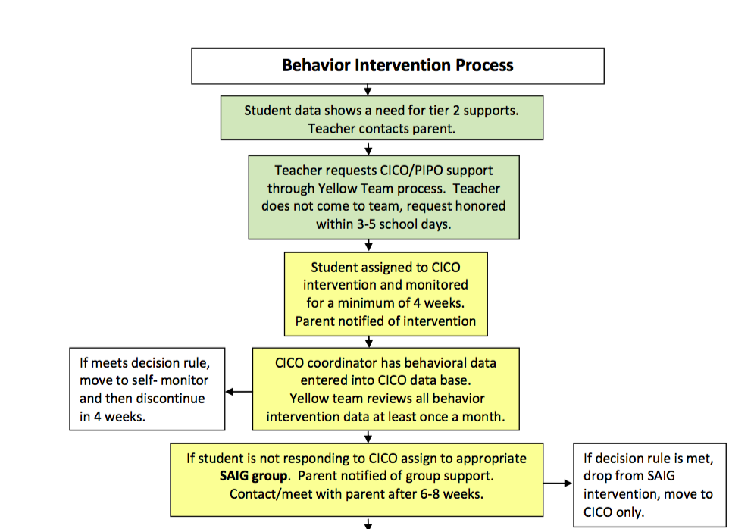

Slide 8
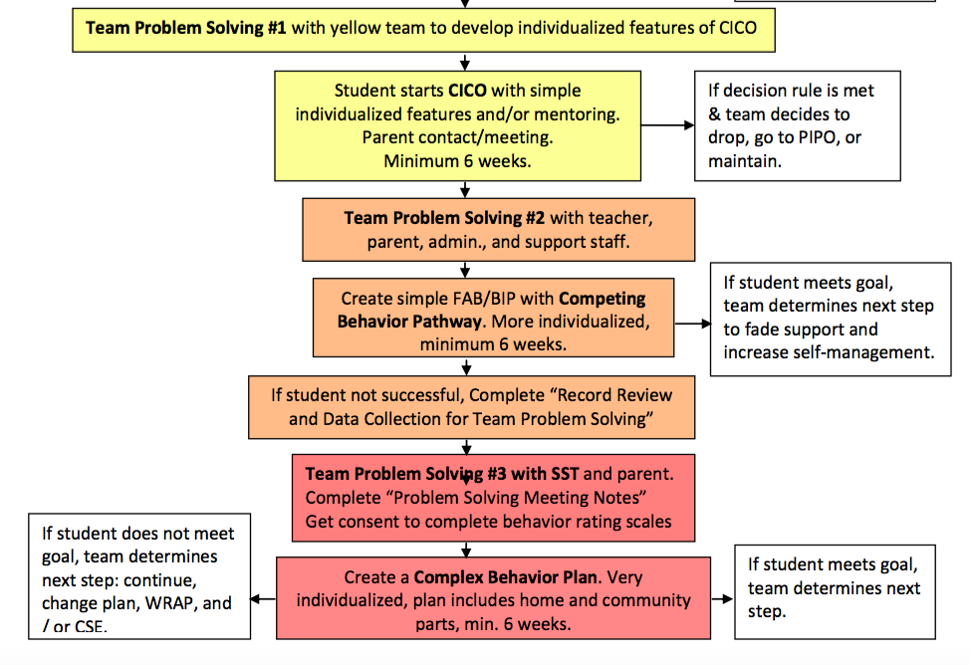

Slide 9
Entry Criteria and Referral Process
Screening Data
Two or More Unexcused Absences in a Month
2-5 Major Referrals
5 Tardies Within Two Weeks
3 or More Health Room Visits in Two Weeks for Unexplained Reasons

Slide 10
Establish Risk Guidelines: Sample At Risk Alert System, Bob Stevens, Charleston County School System
INDICATORS | LEVEL 1 Motivated (Low) | LEVEL 2 Vulnerable (Moderate) | LEVEL 3 Critical (High)
Attendance Number of missed instruction days | 0-5 days absent | 6-14 days absent | 15+ days absent
Age Comparing age to current grade level | <1.0 years above appropriate age for grade | 1.0 to 2.0 years above appropriate age for grade | 2+ years above appropriate age for grade
Grades Passage of current ELA and Math courses | Passing both ELA and Math last quarter | Failing either ELA or Math last quarter | Failing both ELA and Math last quarter
Lunch Student’s meals status | None (full-pay) | Reduced | Free
Suspensions (ISS) Total number of incidents | 1-2 suspensions | 3-7 suspensions | 8+ suspensions
Suspensions (OSS) Total number of incidents | 0 suspensions | 1-2 suspensions | 3+ suspensions
PACT/HSAP ELA Performance Level | Proficient or Advanced | Basic | Below Basic
PACT/HSAP Math Performance Level | Proficient or Advanced | Basic | Below Basic
Lane and Weist, 2015

Slide 11
Functions of behavior
Example
Horner & Sugai at www.pbis.org
Notes:
Attention getting kid video
https://www.youtube.com/watch?v=lXP5rFAJQek
For example-
Many students use off topic comments/inappropriate language to obtain
attention from peers through their reactions and to escape the task at hand.
In this example, social reinforcement is obtained from the peers and the
adult.
Remember reinforcement is positive and negative.
NOTE:
When control is offered as a possible function- think about what is underlying that perception.
Control can be a way:
To hide skill deficits; therefore escaping/avoiding a task
To hide fears around social acceptance; therefore escaping/avoiding a situation
For an individual to assert themselves; therefore gaining/obtaining the attention of peers/adults

Slide 12
Tier 2 problem-solving process
Step 1: Identify and define the main problem/concern/need
What intervention does the student need to address the hypothesized root cause (function) underlying the problem?
Step 4: Evaluate whether the plan worked
Step 2: Determine why the problem is happening to generate solutions
Step 3: Develop and implement a plan
“Identify the least intensive intervention that is likely to address that problem” (Rob Horner)
Clayton Cook, Univ of Minnesota 2018

Slide 13
Intervention Programming from Beginning to End: Intervention Match, Map, Monitor and Meet (IM4)
Match
  Match the student to the most precise and appropriate intervention
Map
  Map out who is implementing core components of the intervention to increase the fidelity with which the intervention is implemented
Monitor
  Gather baseline data and begin monitoring student response to the intervention and intervention fidelity
Meet
  Meet as a team to review data and make a data-driven decision
Clayton Cook, Univ of Minnesota 2018

Slide 14
Set A Standard Meeting Protocol
To Do List From Last Meeting (5 Minutes)
New Student Referrals (25 Minutes)
Progress Updates/Rechecks (15 Minutes)
Meeting Analysis (5 Minutes)
* Once per month review intervention fidelity and outcomes

Slide 15
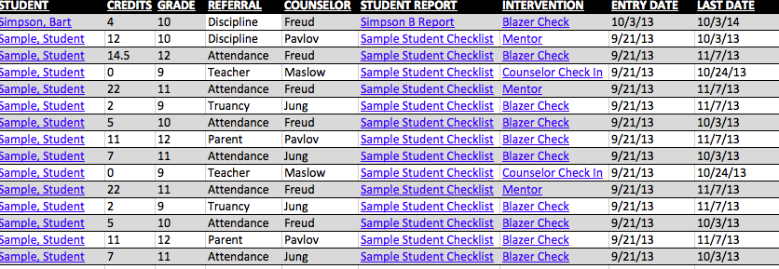
ALL DATA HYPER-LINKED

Slide 16
Bart Simpson – Sample Data
Link to Student Study Team Checklist
SWIS Data
Grades
Attendance
Confidential Teacher Report

Slide 17
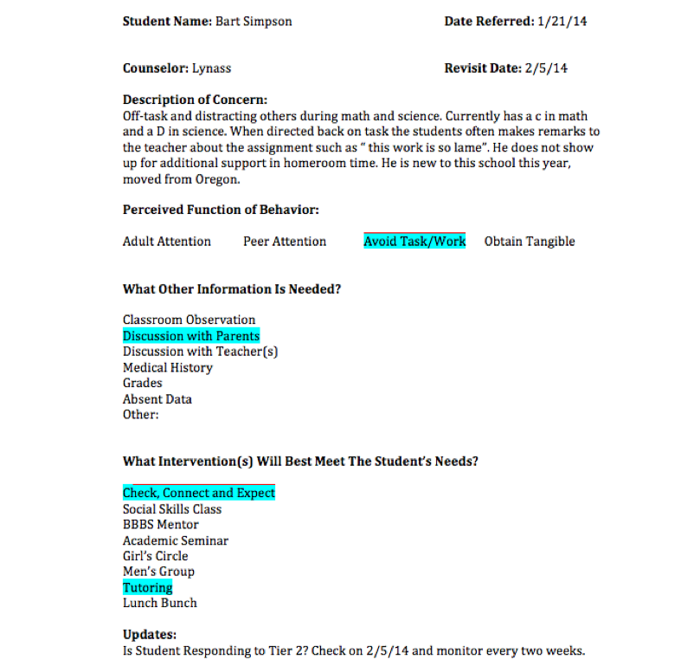


Slide 18
Team Discussion
15
Minutes
Tier 2 Team Is Identified
Team Roles (Facilitator, Note Taker, Data Tracker, ect) Have Been Established
Meeting Process is Identified
We Have Identified The Goals We Want to Initially Address with Tier 2

Slide 19
“Table for Two”
What Are Doing Now For Students In Need of More Support?
What Seems To Be The Most Effective Intervention?
What Barriers Do You Run Into now?

Slide 20
Tier 2 Interventions

Slide 21
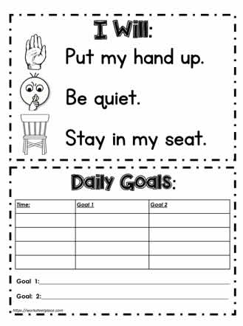
Behavioral Contracts

Slide 22
Difference Between Effective and Ineffective Behavior Contracts
EFFECTIVE BEHAVIOR CONTRACT
INEFFECTIVE BEHAVIOR CONTRACT
Non-negotiated
Describes what the student is doing wrong
Provides no goal statement
Outlines how the student will be punished if problem behavior continues
No other adult follow through with the contract
Negotiated agreement
Describes what the student should do
Provides a goal statement
Outlines what the student will earn as a reward for meeting goal
Teacher uses contract to precorrect and prompt behavior
Clayton Cook, Univ of Minnesota 2018

Slide 23
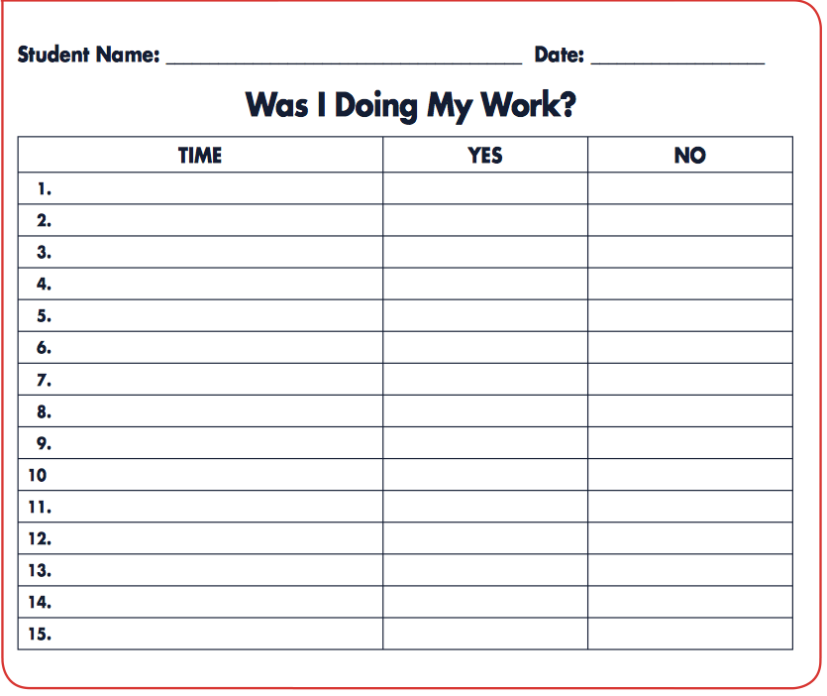
Self Monitoring

Slide 24
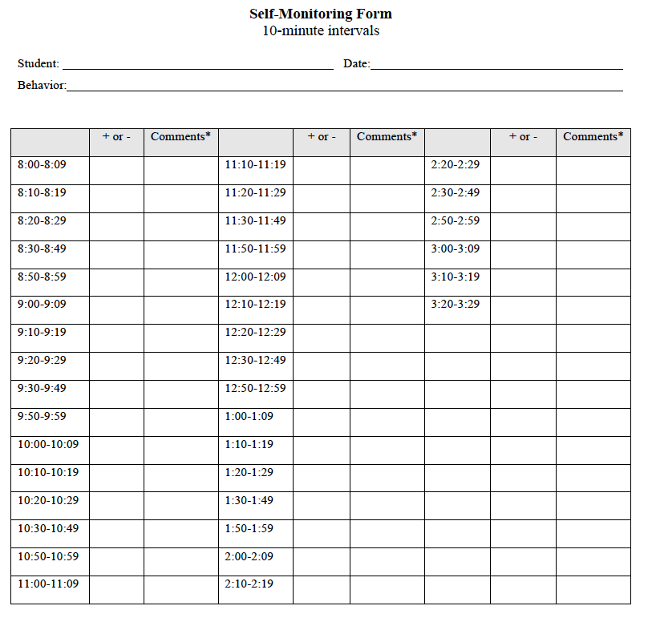

Slide 25
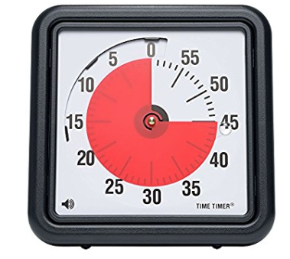
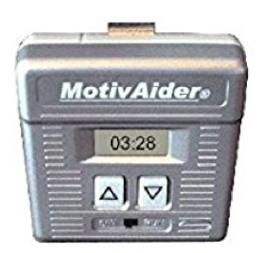

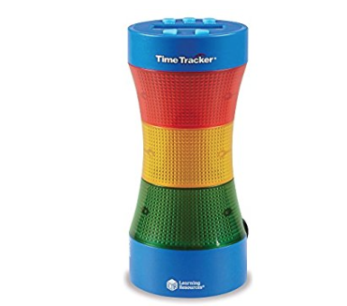
Timer Tools

Slide 26
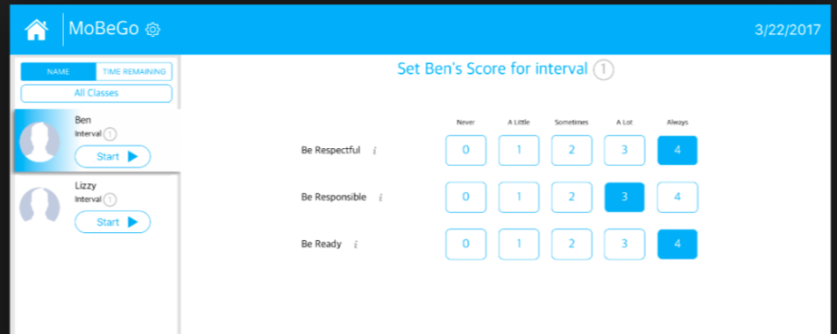
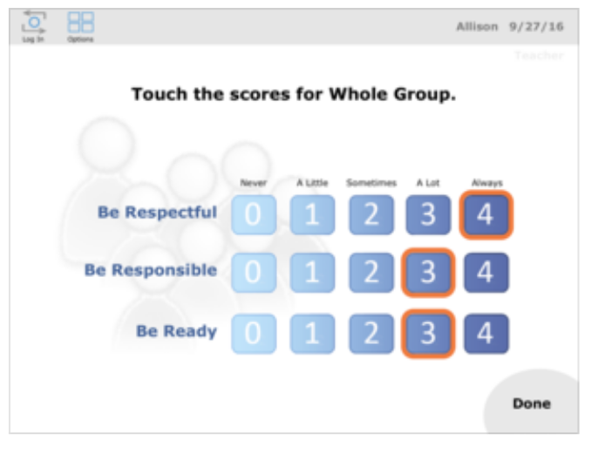
MoBeGo, I-Connect and Score It

Slide 27
Self Monitoring
Set a realistic and attainable goal with the student
Identify what the student should be doing instead of the problem behaviors
Determine how frequently the student will self-monitor and record her behaviors
Combine tracking with a reward component for meeting a preset goal to increase self-regulation and self-control
Use of technological device or natural breaks or transitions to prompt self-reflection and self-recording of behavior
The student must comprehend the self-monitoring chart

Slide 28
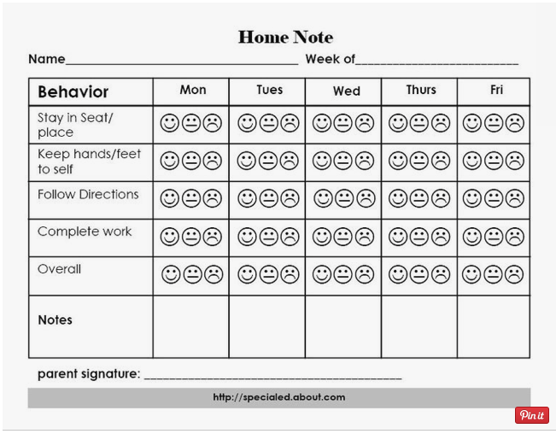
Home Note – Younger Students

Slide 29
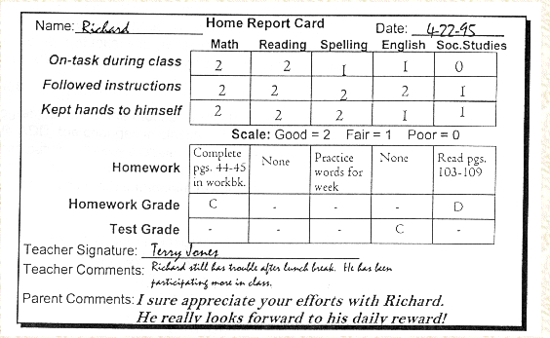
Home Note – Older Students

Slide 30
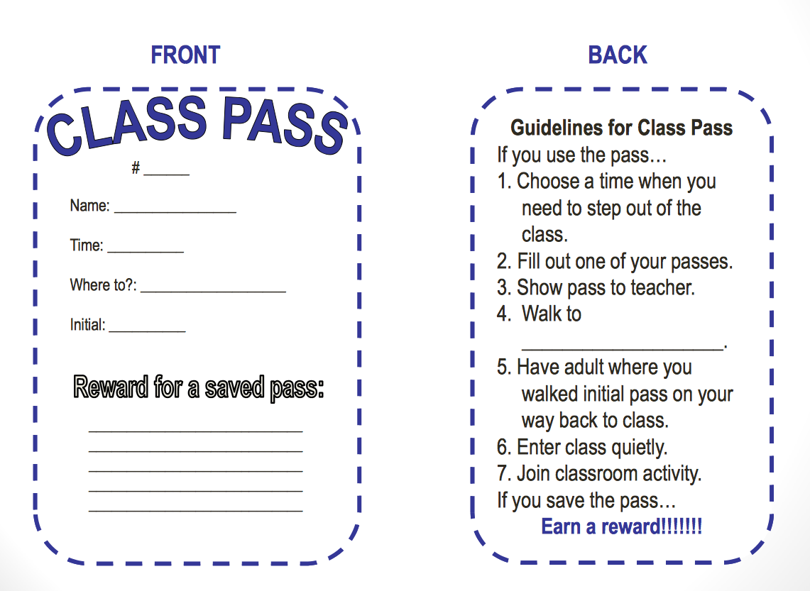
Class Pass Example
From Browning –Wright, D.

Slide 31
Class Pass Intervention
Incentivize students to not use class passes by holding onto them and exchanging them for something even more desirable than escape/break
It works because students:
  Can exercise choice by requesting a break with class pass
  Tolerance for academic work is increased
  Are able to earn access to desired reward/activity based on staying in the presence of the difficult, boring, or frustrating academic task
From Browning –Wright, D.

Slide 32
Class Pass Intervention
CPI is for students who engage disruptive classroom behavior
  Work may be too difficult, views class as boring, or simply doesn’t like a subject
  Allow students to escape/avoid academic tasks for a pre-determined amount of time by issuing class pass
  Engage in a preferred activity for a certain amount of time
Students must be taught how to appropriately ask for and take a break.
Pre-determine the break length.
Determine the # of break cards.
From Browning –Wright, D.

Slide 33
Team Time
15
Minutes
Based on what you just heard, which of these interventions do you think would be best to present to your staff first?
What would be the initial steps to introduce the intervention(s)?

Slide 34
Check-In and Check-Out Programs

Slide 35

Discussion Activity
One Word to Describe An Adult From Your Days As a Student That You Had A Positive Relationship With. Say the word and then describe why you chose that word.

Slide 36
Check-in and Check out Variations - What is the Difference?
Check and Connect
Check, Connect and Expect
Check-In and Check-Out Variations
Behavior Education Program
Academic Behavior Education Program

Slide 37
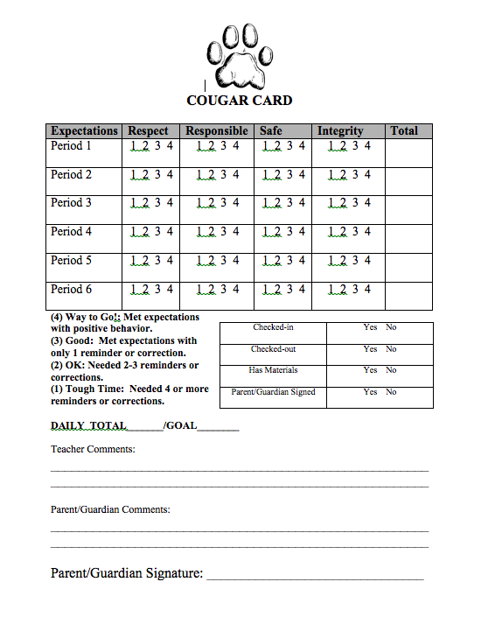

Slide 38

At The Heart of All - Relationships

Slide 39

Check & Connect Overview
Check & Connect is a structured mentoring intervention to promote student success and engagement at school and with learning through relationship building and systematic use of data.
This photograph and the remaining stock photos were used with permission from Microsoft.
Notes:
Check & Connect targets students in K-12 who are showing signs of disengagement.
Structured means it follows a fairly standard set of procedures, but it is not scripted. There is flexibility so that mentors can meet the needs of individual students. Check & Connect is not a one intervention fits all program. Also, it is critical that the mentors keep the focus on education. This is something that makes Check & Connect different than other mentoring programs people might be familiar with.

Slide 40

Focus on School Completion
Check & Connect emphasizes school completion rather than dropout prevention
School completion = high school graduation with academic and social competence
Merely keeping students in school until graduation is not sufficient
Notes:
An important premise of C&C is the shift in focus from preventing negative outcomes (dropout) to promoting student competence, school success, and school completion (positive outcomes)
In some cases, students graduate without being college-ready or prepared to succeed in various postsecondary options. We want to ensure that students are ready not only to earn a diploma but for life after high school.

Slide 41
Check and Connect – Video http://checkandconnect.umn.edu/

Slide 42
Student Engagement in C&C
Academic
Cognitive
Behavioral
Affective
Observable Engagement
Internal Engagement
Notes:
Intervention is really informed by the way we define student engagement. C&C’s theory of student engagement is multidimensional. We want to engage students academically, behaviorally, cognitively, and affectively at school and with learning. We have to go beyond just the easily observed types of engagement and think about students’ cognitive and affective engagement as well.
Academic engagement and behavioral engagement are easy to observe and measure. In fact, schools are already measuring these without really thinking of them as engagement measures.
Academic engagement is students’ active participation in learning. Students who are academically engaged are spending time on task, completing assignments, earning good grades, and earning credits toward graduation
Behavioral engagement encompasses school-related conduct and participation in school-related activities, so students who are following school rules, attending school, participating in extra-curricular activities, and engaging in positive behavior are behaviorally engaged.
Cognitive and affective engagement are more difficult to observe
Cognitive engagement is students’ investment in their learning, valuing of learning, perceiving learning as relevant to their futures, and using cognitive strategies to regulate their learning. Students who are cognitively engaged set goals for themselves, monitor progress toward their goals, put forth effort in their work, and can see the importance of schoolwork. This is really the “I can” and “ I want to” part of engagement.
Affective engagement is students’ sense of belonging in school and identification as a learner and with the school. Students who are affectively engaged feel good about being at school. They are connected to peers and adults. They see themselves as learners and feel like they belong in school. This is really the “I belong” part of engagement.
Cognitive and affective engagement are critical because it seems that they precede academic and behavioral engagement. This means that being cognitively and affectively engaged leads to having good grades, following the school rules, attending, and doing well in school. Therefore, many of the interventions that Check & Connect mentors implement focus on cognitive ad affective engagement, trying to help students say I can, I want to, and I belong.
Refer to page 6 of the manual for more information.
HANDOUT: STUDENT ENGAGEMENT pgs. 5-6 in the binder

Slide 43
Early Warning Signs
Attendance
  Absent 10% or more of school days
Behavior
  Two or more mild or more serious behavior infractions
Course performance
  An inability to read at grade level by the end of 3rd grade;
  A failure in English or math in 6th through 9th grades;
  A GPA of less than 2.0;
  Two or more failures in 9th grade; and
  Failure to earn on-time promotion to 10th grade.
(Balfanz, Bridgeland, Bruce, Fox, 2012)
More information about EWS: http://www.betterhighschools.org/ews.asp
Notes:
Research has identified the following early warning signs of disengagement (or being at risk for dropping out)

Slide 44
Attend-Engage-Invest Continuum
Attend
Engage
Invest
Students attend school regularly and successfully complete high school
Students engage academically, behaviorally, cognitively, and affectively in school
Students set goals for their future and invest time, effort, and talents into reaching those goals
Goal:
Dropout prevention
Goal:
School completion with academic, social, and emotional competence
Goal:
Readiness for achieving college, career, and life goals
Notes:
Successful school completion goes beyond dropout prevention
We want students to:
Attend
Engage academically, cognitively, behaviorally, and affectively
Invest in their futures
Student engagement interventions are powerful in part because they orient our efforts toward school completion. School completion is defined as graduating with sufficient academic and social skills to partake in post-secondary or work.
Interventions must be provided in a timely manner
Philosophy of the continuum: attend goal, engage goal, invest goals
We want students to attend, then to engage academically, cognitively, behaviorally, and affectively; meaning to occupy themselves and become involved with academic material and the social life of school.
To invest means to use, give, or devote time or talent to achieve a goal.
Personal investment refers to the choice students have to invest their motivation in a future outcome
Direction: the kind of choices and the persistence of an action
Intensity: the willingness to perform and take the risks
Quality: self-reflection and thoughtful learning process – using cognitive strategies, weighing risks involved
Personal investment is sustained within relationships.
Disengaged students can be at very different places on this continuum. Mentors must work to set goals for intervention based on where the student is at. (Manual page 63)
Attend – giving a student an alarm clock; working on morning schedule
Engage – getting kids connected to extra-curriculars; teaching them how to be attentive in class
Invest – future goal setting; college planning
HANDOUT: BEYOND DROPOUT PREVENTION: ATTEND-ENGAGE-INVEST p. 45-48 in binder

Slide 45
Who Can Serve as Mentor?
Outside hire
  Experience in education or human services related field or equivalent education and experience
  Experience working with youth
Existing staff
  Teachers, case managers, counselors, school psychologists, social workers, educational assistants
Community volunteers
Notes:
Our research projects all included full-time mentors, thus our evidence for Check & Connect is based on using full-time mentors. More and more schools are using existing staff as mentors.
HANDOUT: IMPLEMENTATION OPTIONS
Read through the implementation options handout or encourage participants to take time and read through the handout and ask questions they may have.
Typical Day/Week
HANDOUT: A DAY IN THE LIFE OF AN ELEMENTARY SCHOOL Mentor (p. 15)
HANDOUT: SAMPLE TEACHER/MENTOR WEEKLY ACTIVITIES (p. 16)

Slide 46
“Check” Procedures and the Monitoring Form

Slide 47
Systematic Monitoring
“Check” = systematically monitoring target students’ level of engagement and educational progress
  Core component that is non-negotiable
  Essential for students at risk of disengagement or dropout
Notes:
Systematic monitoring is essential for students at risk of disengagement of dropout for two reasons:
It provides a systematic and efficient way to connect students with immediate interventions; and
It provides a data-based link to students’ educational progress and performance.

Slide 48
Systematic Monitoring (cont.)
What is checked? “Check” data are selected indicators of alterable risk for disengagement:
  Absences
  Tardiness
  Missing assignments
How are students' data generally accessed?
  Online student information system
  Student records
  School personnel such as attendance clerks and teachers
  Grades
  Credits accrued
  Behavioral referrals
Notes:
Now that students often have access to their grades online, some mentors complete the monitoring form with students. The students come to the mentor’s room or office, log into the grade book system, and report their grades and attendance to the mentor – it’s empowering for the student to do this self-monitoring of progress and hopefully gets them in the habit of checking their grades on their own.
May have to set up a special “0 hour” class for Check & Connect in the grade book system to be able to access data for students not in your classes or to avoid giving mentors administrator access to all students.

Slide 49
Systematic Monitoring (cont.)
How often is a student’s performance checked?
  At least weekly
  More often, even daily, if the student is showing increased signs of disengagement
How can the monitoring form be used?
  As a communication tool with students, parents, and teachers
  To demonstrate student progress over time
  To monitor fidelity of implementation
Notes:
Reminder: The monitoring form serves many purposes! It’s not just collecting data for data sake. It’s a communication tool, it captures progress others won’t see so that you can celebrate successes with students and families, the data can be used to inform intervention, and the form can be used to monitor fidelity of implementation.

Slide 50
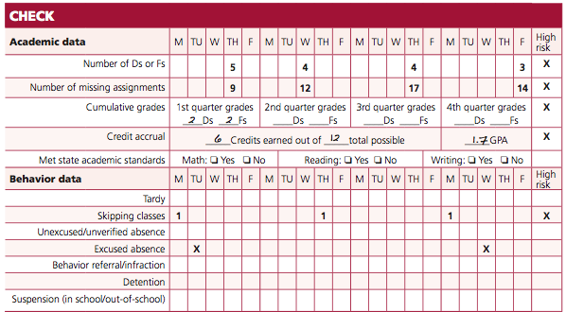
Systematic Monitoring (cont.)
How are indicators checked?
Notes:
The Check & Connect Mentors use a Check & Connect monitoring form to gather Check information on the students they are working with. The information on this form is shared with the student through discussion. The purpose of gathering Check data is: 1. The student data informs the level of service and the nature of the service to the student and 2. The systematic gathering of this data is what makes Check & Connect different from the traditional relational mentoring programs.
The monitoring form is site-specific. Your school team will decide what alterable indicators of disengagement to monitor and then adapt the form to fit your school needs.
Refer to page 45 in the manual. Walk through how to complete the monitoring form. (same as image on slide)
Use numbers to indicate number of Ds or Fs, missing assignments, credits, GPA, etc.
Use check marks to indicate absences (or numbers if preferred)
Use numbers to indicate number of skips, tardies, detentions, etc.
Manual pages 99-104 – elementary, middle, and high school forms. Provide some time to look over the forms.

Slide 51
Implement “Connect” Interventions

Slide 52
Connect
Personalized, data-based intervention
Mentors consider:
  “Check” data
    Patterns in the data
    Level of risk
  Student’s needs and perspective
  Family influences and circumstances
  Available school and community resources
Notes:
The strength of C & C is its responsiveness to individual student needs. There is not one best intervention strategy to use. (pg. 47 in manual)

Slide 53
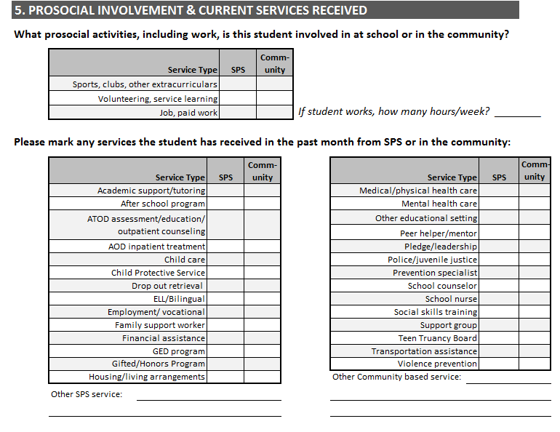
Report “Connect” Data Monthly
Notes:
Last part of Monthly Service Information. This should be pretty familiar, but we added positive engagement section – just like Assessment Form.

Slide 54
Activity:
Identifying Strengths
15
Minutes
Review the case study
Identify strengths and protective factors of the student, family, and school.
What are the connections you think would be important to support Devon?

Slide 55
Basic vs. Intensive Intervention
Basic intervention
  All students receive basic intervention
  Occurs at least weekly
Intensive intervention
  Supplemental to basic intervention
    Students demonstrating high risk are provided intensive intervention in addition to basic intervention
Notes:
All students receive basic intervention!
Students showing high risk on the monitoring form receive intensive interventions.

Slide 56
10 Implementation Steps
Determine indicators of student disengagement
Identify students at risk of disengagement or dropout
Select or hire mentors
Organize existing resources for intervention
Get to know students, teachers, and parents
Use “check” procedures and the monitoring form
Implement “connect” interventions
Strengthen the family-school relationship
Provide mentor support and supervision
Evaluate program implementation
Notes:
Items 1-4 are steps in preparation of implementation and 5-11 are the steps of implementation.
Refer participants to the manual where these steps are listed and covered one by one, starting on page 21.
Refer participants to the planning guide. Come back to this throughout the implementation steps presentation. Use as activities after each step when time allows.

Slide 57
Check and Connect Summary
Can be used at all grade levels, but often used to address academic disengagement, students at-risk for drop out and truancy issues at the secondary level.
A trained C&C mentor with adequate FTE should be in place. Training normally takes 1.5 days.
All school staff need to understand what C&C is and what type of student is a good fit for the intervention.

Slide 58
Team Time
15
Minutes
Based on what you just heard, do you see Check and Connect being an intervention your school could implement?
What would be the initial steps to set up and introduce the intervention?

Slide 59

Behavior Education Program (BEP)

Slide 60

Check, Connect and Expect: A Check-in and Check Out Intervention

Slide 61
CICO Training Video
https://www.youtube.com/watch?v=vP7GJ72UxsA&feature=youtu.be

Slide 62
Check, Connect, & Expect
(CC&E) Program
Secondary-level intervention (Expanded CICO) implemented by a paraprofessional.
Includes four program phases:
  Basic
  Self-Monitoring
  Graduates
  Basic Plus (Social Skills & Problem Solving)
Notes:
62

Slide 63
Student Meets CC&E Criteria
Program Phases
Daily Program Routine
Basic Program
Morning
Check-in
Basic Plus Program
(as needed)
Parent
Feedback
Teacher
Feedback
Self-Monitoring
Afternoon
Check-out
Graduation

Slide 64
Basic Program
Student check-in and check-out with coach
Teacher Feedback/Daily Progress Report
Problem solving if needed
Parent communication
Reinforcement & Criterion Shift for non-responders

Slide 65
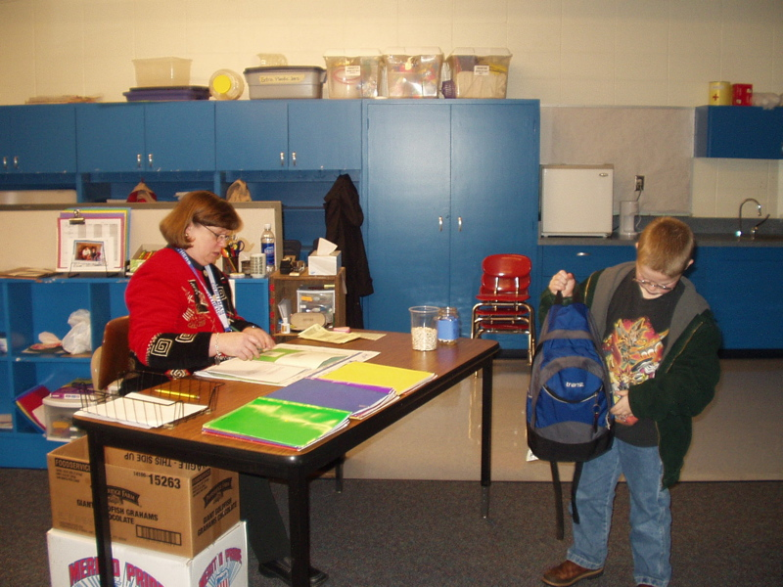
Checking In
Success
95% of
14,000 times

Slide 66
Basic: Check-in
Convenient location; consistent routine; efficient
Students receive the DPR with a goal
Coach collects signed DPR
Coach and students review expectations
Materials/Homework Check
Receive positive reinforcement for check-in
Positive Relationship building with students
Provide reminders of expectations, social skills, and problem solving skills
https://www.youtube.com/watch?v=7rSNMC14Rq0

Slide 67
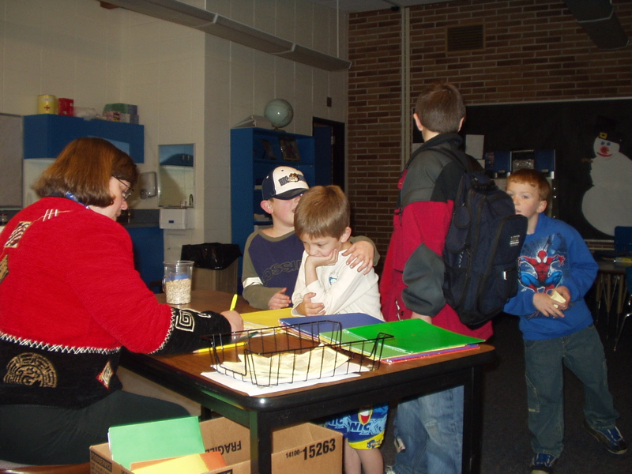
Checking out
92% of
time
Terrific

Slide 68
Basic: Check-out
Convenient location; consistent routine; efficient
Positive end to the school day/class period
Coach gives behavioral feedback/correction on what needs to be different next time
Coach provides praise & reinforcement for meeting goal
Afternoon Check Out: https://youtu.be/8DexDQtVWMk
Notes:
DVD: check-out

Slide 69
Coach Role
    Serve as a positive role model & connect with student
    Monitor progress of students with the Daily Progress Report
    Inform parents of student progress
    Complete daily data entry
    Provide social skills instruction, problem solving instruction, and academic support as needed
    Review student progress with school coordinator

Slide 70
Check in/Out Teacher’s Role:
Score Students On The Daily Progress Report Card At Designated Times
Give Student Clear, Concise Behavioral Reminders about Expected Behavior When Misbehavior Occurs
Reminders Linked to Expectation, with a Description of the Problem Behavior and Desired Behavior.
Give Specific Positive and Corrective Feedback To Students at Each Scoring Period
Use Growth Mindset Language Often
Work With Coach to Schedule Other Supports or Services

Slide 72

Shark
Code
Checked in | YES NO
Checked out | YES NO
Has Materials | YES NO
Parent Signature | YES NO
Student: __________________________________ Date: ____________ M Tu W Th F Goal: ______
Expectations | Morning to Recess |  |  |  | Recess to Lunch |  |  |  | Lunch to Recess |  |  |  | Recess to End |  |  |  | Total
 | Tough Time | So-So | Good | AWE some | Tough Time | So-So | Good | AWEsome | Tough Time | So-So | Good | AWEsome | Tough Time | So-So | Good | AWE some
Safe | 1 | 2 | 3 | 4 | 1 | 2 | 3 | 4 | 1 | 2 | 3 | 4 | 1 | 2 | 3 | 4
Honest | 1 | 2 | 3 | 4 | 1 | 2 | 3 | 4 | 1 | 2 | 3 | 4 | 1 | 2 | 3 | 4
Accountable | 1 | 2 | 3 | 4 | 1 | 2 | 3 | 4 | 1 | 2 | 3 | 4 | 1 | 2 | 3 | 4
Respectful | 1 | 2 | 3 | 4 | 1 | 2 | 3 | 4 | 1 | 2 | 3 | 4 | 1 | 2 | 3 | 4
Kind | 1 | 2 | 3 | 4 | 1 | 2 | 3 | 4 | 1 | 2 | 3 | 4 | 1 | 2 | 3 | 4
Totals
Comments: | 4 = AWESOME: Met expectations with positive behavior; worked independently without any corrections/reminders.
 | 3 = GOOD: Met expectations with only 1 reminder/correction
 | 2 = SO-SO: Needed 2-3 reminders/corrections
Parent/Guardian Signature: ___________________________ | 1 = TOUGH TIME: Needed 4 or more reminders/corrections
Note: Parent comments can be included on the back of this form

Slide 73
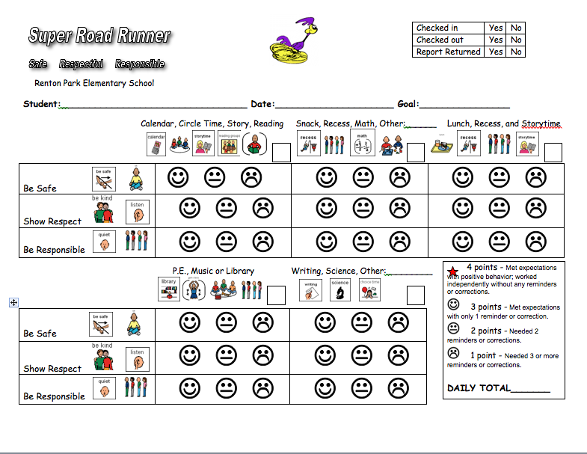

Slide 74
Schedule of Reinforcement
Daily - daily goal
5 day - meets daily goal 5 times
15 day - meets daily goal 15 times
Periodic Celebrations
Graduate celebrations - at graduation from the program

Slide 75
Self-monitoring (SM)
6-8 weeks in Basic meeting criteria 80% of the time
SM can be faded across 2-5 weeks
Students check-in and out and receive DPR feedback from teacher
Students rate their own behavior on DPR
Teachers rate behavior on DPR
Coach determines partial agreement (80%)
Coach reviews SM purpose with teachers prior to starting

Slide 76
CICO Trading Post
Maintaining Consequence | Wants Attention | Wants something | Wants to escape attention | Wants to avoid something
100 pts | Take note to office/teacher Ask a peer to play/read/draw Be a leader Principles recess | Trip to treasure chest Choose a snack Choose a 5 min. activity School wide sticker Principles recess | Computer time by self | Short break Alternative activity
250 pts | Computer with a friend Extra sharing time | More time for selected activity Free ticket to sporting event | Time alone Independent work space | Alternative assignment
400 pts | Out to lunch with TBA Class recess, free time, or popcorn party | New school /art supplies |  | Get out of school early
Notes:
76

Slide 77

Graduation
Celebrate each graduation
Continue quarterly events
Collect & enter monthly self-report DPR
Consider Graduates as program assistants

Slide 78
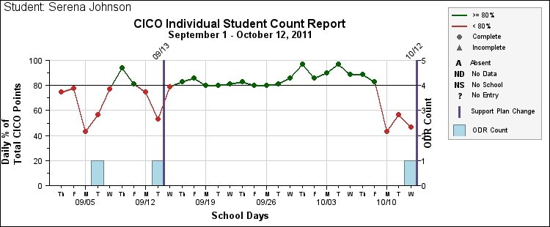
Tier 2 Impact Data

Slide 79
Tracking Student CICO Progress
(number = % of total daily points)
Date | Jason | Leanne | Juan | Kiran | Alexa
1/16/03 | 85 | 95 | 100 | 80 | 65
1/17/03 | 100 | 100 | 100 | 75 | 77
1/18/03 | 77 | 0 | 100 | 85 | 63
1/19/03 | 80 | 75 | 95 | 92 | 85
1/20/03 | 50 | 89 | 77 | 89 | 90
1/23/03 | 45 | 0 | 100 | 95 | 95
1/24/03 | 65 | 67 | 85 | 100 | 78

Slide 80
Fidelity/Treatment Integrity
COMPONENT | Absent (0) | Low- 25% of time (1) | 50% of the time (2) | 75% of the time (3) | 100% of the time (4)
I greet the students in the morning in a positive, friendly manner.
I provide the students positive, specific verbal feedback after each subject. | CICO-TI example teacher
I provide the students specific verbal feedback after each subject on items to improve on.
I reinforce the students throughout the day using the universal recognition system.
I provide pre-corrects to the students.
I remind the student to check-in.
I remind the student to check-out.
I check to make sure the DPR is in the student’s backpack.
Provide staff training and practice delivering their aspect of the intervention
Provide coaching, problem solving and encouragement early on.
Data is useless if fidelity data does not exist

Slide 81



Orient, Teach Students to Be Successful in CCE/CICO
https://youtu.be/GMo5aAm2rVw- realistic school made video on CICO that is designed for student orientation but good overall model! Though adult feedback could be more specific.

Slide 82
Staff Orientation
How a students gets into check, connect and expect
What time/support may be asked of staff
What can you expect to see from the CCE coach
What can you expect to see from the student

Slide 83
C&C and CCE Discussion
15 Minutes
What do you see as the barriers to implementing CCE?
What are your reservations about CCE?
What do you see that is needed to support CCE?
Can you identify 3-5 students to try this out with?

Slide 84
Check In/Out Videos
Behavior Education Plan Model
Morning Check In: https://youtu.be/8DexDQtVWMk
Afternoon Check Out: https://youtu.be/8DexDQtVWMk
General Overview; https://youtu.be/rix3422NF3A

Slide 86
Helpful FREE Resource on Addressing Behavior Challenges
Strengthening Student Educational Outcomes: Technical Report on Best Practices and Strategies for Reducing Disruptive Behavior
OSPI & LAP Services- but applies to ALL students
http://www.k12.wa.us/SSEO/BehaviorMenu.aspx

Slide 87
Final Team Time
Use this time to complete the TFI for Tier 1 and Tier 2
Outline the steps needed to start to get Tier 2 interventions in place at your school.
Make sure to timeline those action steps.

Slide 88

Final Question and Answer
Lori Lynass Ed.D. – lynassl@gmail.com
Bridget Walker Ph.D. – bridgetwalkerphd@gmail.com

